Slide 1
BASH Flow Control
Scripting Essentials
Dr. Burkman

Slide 2
BASH Flow Control
Recommended books if you are planning to use Linux and BASH:
http://linuxcommand.org/tlcl.php
https://nostarch.com/tlcl2

Slide 3
BASH Flow Control
Focus here is on elements required to complete our scripts.
Nano <filename.sh> to make the file and open the editor
#! /bin/sh first line (this is the shebang)
Ctrl x to exit, y to save, enter
Chmod 750 <filename.sh> to make the script executable
./<filename.sh> to execute the script
Tip: after entering some commands you can scroll through them with the up/down arrow keys on your keyboard
Tip: Precision is key with BASH. One errant space will end you.

Slide 4
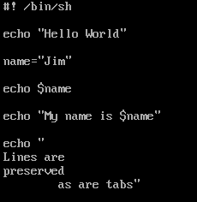
Writing Output
Write output to the screen with echo.
Text goes in double quotes.
Variables in the double quotes will show their values.
Spaces, new lines etc. will print out (echo –e)
echo by itself will make a blank line
echo –e if you want to use \n
Comment lines by putting # in front of the line
Clear will clear the screen

Slide 5

Getting User Data
We get data from the user with the read command. We use –p for the prompt, and put the variable name at the end.
Note: variables are assigned without using $. But we reference variables with $.

Slide 6

Assigning values to variables
There cannot be a space between the variable name and the value:

Slide 7
Numeric Comparisons
Like PowerShell
-eq, -ge, -gt, -le, -lt, -ne
Logical operators
|| or
&& and

Slide 8
Conventions
Conventions
For variables that have values that don’t change, put them in upper case
YEAR=2020
All other variables just be consistent
my_name
myName
MyName

Slide 9
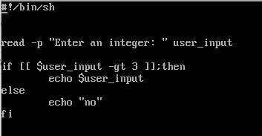
IF Statements
if [[ statement ]]; then
do these things
else
do these things
fi
Note: there has to be spaces on either side of the condition being checked by the IF statement
http://tldp.org/LDP/Bash-Beginners-Guide/html/sect_07_01.html

Slide 10
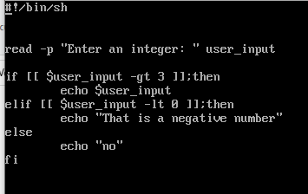
IF Statements
if [[ statement ]]; then
do these things
elif [[ statement ]];then
do these things
else
do these things
fi
It works without indenting but that’s poor readability. Don’t be that person.

Slide 11
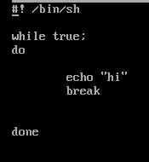
While
while true;
do
code stuff
done

Slide 12
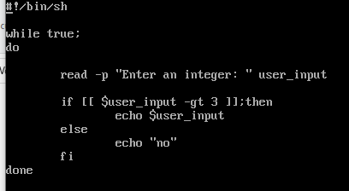
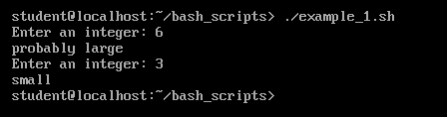
While

Slide 13
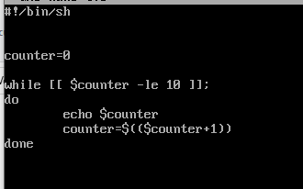
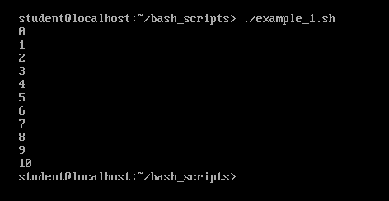
While

Slide 14
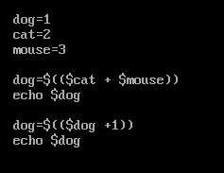
Adding the result to a variable
You cannot type dog=($cat + $mouse)
You have to type dog=$(($cat + $mouse))
You cannot type dog += 1
You have to type dog=$(($dog + 1))

Slide 15

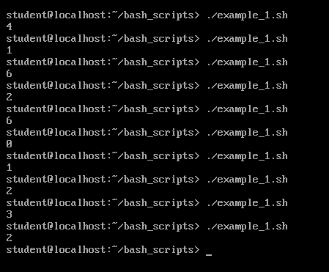
Getting random values
Linux will grab you a random integer. You can just type echo $RANDOM at a command prompt. You cannot specific a lower or upper bounds, though. So we have to take the modulus of that random number.
Mod 7 of a number will give us the integer amount remaining after dividing that number by 7. So values might be 0, 1, 2, 3, 4, 5 or 6. That’s how we can get values between 0 and 6.

Slide 16

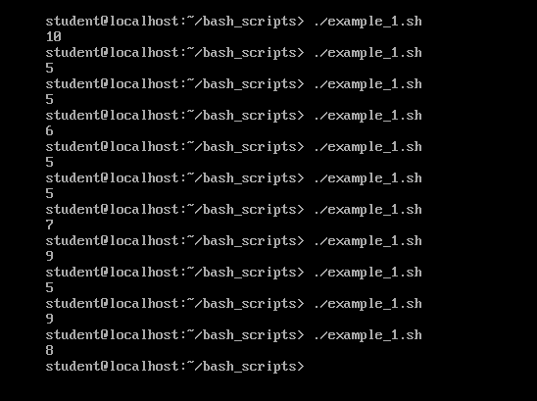
Getting random values
If I wanted values between 5 and 10, I’d need to generate values 0 through 5 and add 5. So mod 6 will give me values 0 through 5. So..

Slide 17

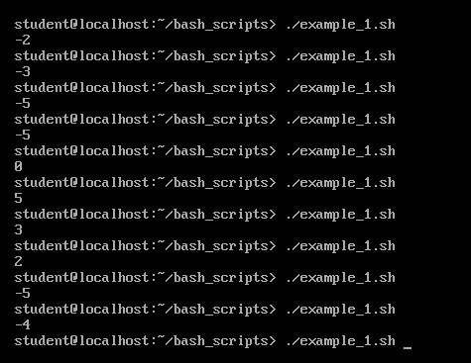
Getting random values
If I want numbers from -5 to 5 then I’ll need to generate numbers from 0 to 10 and subtract 5. Mod 11 will get me numbers from 0 to 10, so..

Slide 18

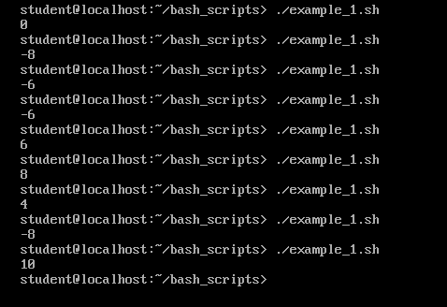
Getting random values
And if I want to multiply that result by 2:

Slide 19
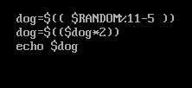
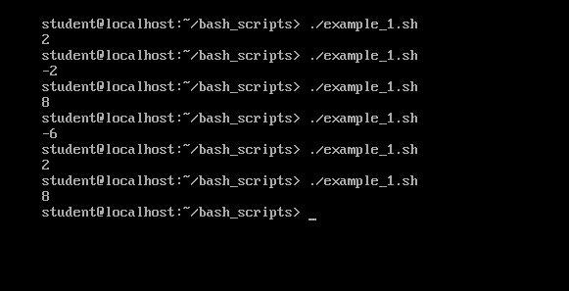
Getting random values
Or I could take it in two steps:

Slide 20
More in Tutorial
I’ll cover a couple more concepts in the video tutorial this time so be sure to watch that and code along with me.
for i in {0..10..2}
do
echo "Welcome $i times"
done
#int check
[[ $var =~ ^[+-]?[0-9] ]]
cat=15
for (( c=1; c<=$cat; c++ )) or c--
do
echo "Welcome $c times"
done

Slide 21
Nano Tips
Ctrl-6 to set mark
Alt-6 to end mark
Ctlr-U to paste
Alt U to undo
Alt E to redo
Hold shift, use arrows to highlight
Then Alt ^ to copy
Ctl-U paste

